Slide 1


Find My College
Guide Name [Dr K. Sai Madhuri] Assistant Professor
Computer Science and Engineering (Data Science)
Date: 28/03/2026
Prepared by: 2026/Minor/A/02

Slide 2
Contents
Abstract
Introduction
Existing System
Disadvantages of Existing System
Proposed System
Advantages of Proposed System
Hardware and Software Requirements
Architecture
References

Slide 3
Abstract
Choosing the right college after entrance exam results is a challenging and time-consuming task for students, as it depends on multiple factors such as entrance exam rank, category, preferred branch, quota, location, and previous year cutoff trends.
The proposed Find My College web application helps students predict suitable colleges based on their academic profile and preferences. The system compares user inputs with historical cutoff data stored in a database and generates a list of colleges where the student has a possible chance of admission.
This system aims to provide a fast, accurate, and user-friendly solution that reduces confusion during counselling and helps students make informed admission decisions

Slide 4
Introduction
• After the declaration of entrance exam results, students face confusion due to the availability of large amounts of scattered information related to colleges and admissions.
• Manual comparison of cutoffs, placements, and reviews from different sources is inefficient and prone to errors.
• Find My College aims to simplify this process by providing a centralized platform that offers personalized college recommendations and relevant details.
• Students often struggle to understand their actual chances of admission, as there is no clear indication of eligibility or probability based on rank and cutoff trends.
• Lack of reliable guidance during the counselling process can lead to poor decision-making and missed opportunities for suitable colleges.

Slide 5
Existing System
• Students manually search for college cutoffs, placement statistics, and reviews across multiple websites and platforms.
• There is no personalized recommendation system based on rank, category, and preferences.
• Students often rely on peer suggestions or unofficial sources, which may be inaccurate or outdated.
Ex: Such as Shiksha,TG EAPCET

Slide 6
Disadvantages of Existing System
• The existing system is time-consuming and requires manual comparison of data from multiple sources.
• It lacks personalization and does not clearly indicate admission probability for individual students.
• Placement data and student reviews are not integrated into the decision-making process.
• Due to scattered and outdated information, students may miss eligible colleges or make poor choices.

Slide 7
Proposed System
• The proposed Find My College system is an automated college recommendation platform based on student academic details.
• It accepts inputs such as entrance exam rank, category, preferred branch, state, and quota.
• The system compares user data with historical cutoff trends stored in a database to identify eligible colleges.
• It also provides placement statistics, student reviews, and detailed college information for better guidance.
• In addition, the system guides students through the college application process by providing information on admission procedures, required documents, and application steps for each recommended college.

Slide 8
Advantages of Proposed System
• The system saves time and effort by automating the college selection process.
• It provides accurate and personalized college recommendations based on historical data.
• Integration of placement statistics and student feedback helps students evaluate colleges effectively.
• The user-friendly interface reduces confusion during counselling and improves decision-making.

Slide 9
Hardware and Software Requirements
• The system requires a computer with a minimum of Intel i3 processor, 4 GB RAM, sufficient storage space, and an active internet connection.
• Software requirements include Windows or Linux operating system, Python programming language, and a web browser.
• The frontend is developed using HTML, CSS, and JavaScript, while the backend uses Flask or Django.
• MySQL or SQLite is used for database management, and development tools include VS Code or PyCharm.

Slide 10
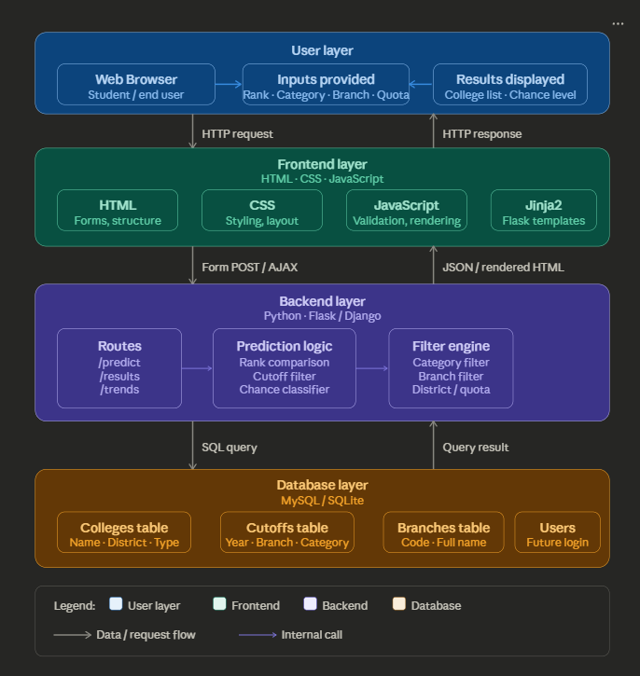
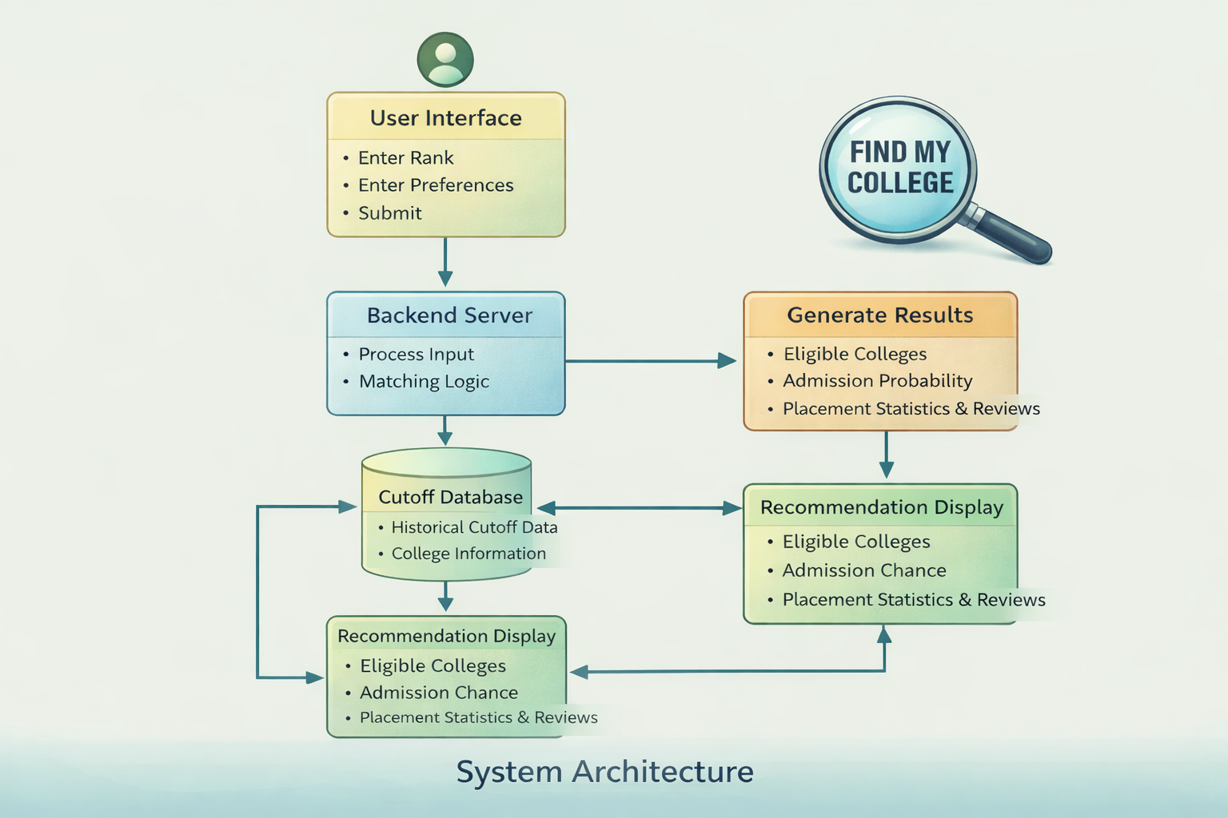
Architecture

Slide 11
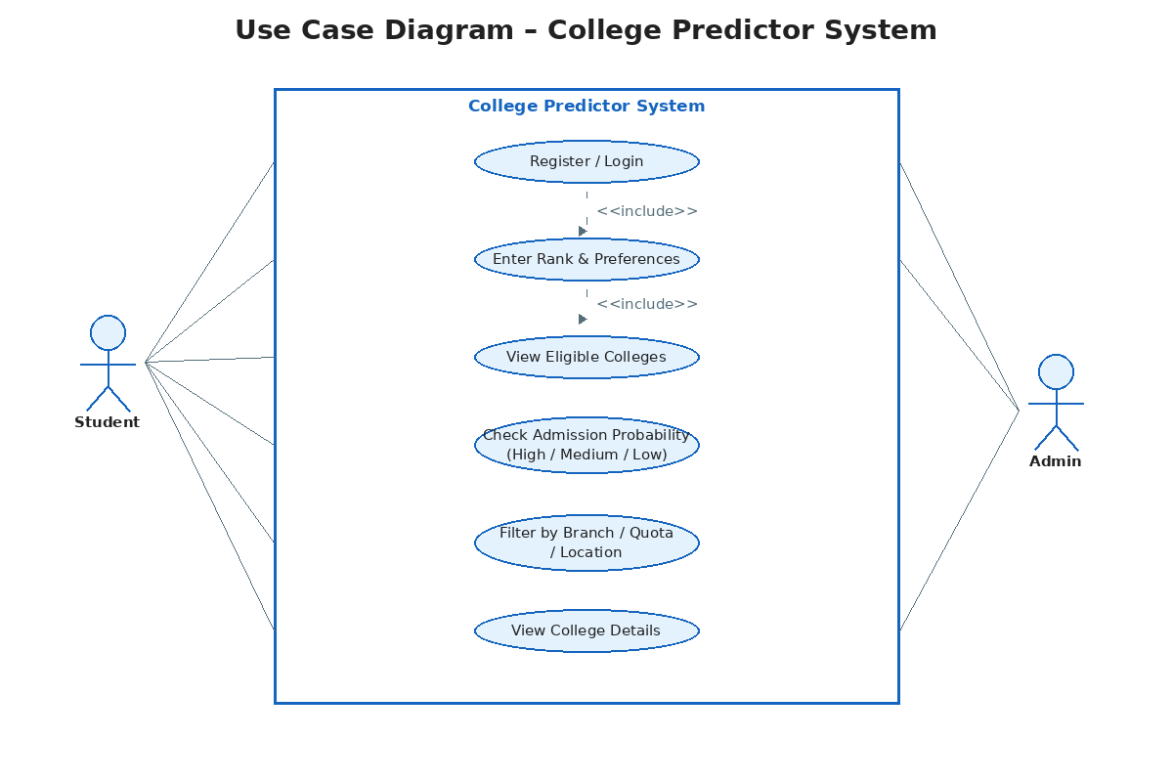
Use case diagram
• The system architecture consists of a user interface, backend server, database, and recommendation logic.
• Users enter academic and preference details through the web interface.
• The backend processes the input data and compares it with historical cutoff information stored in the database.
• Eligible colleges along with admission probability, placement statistics, and reviews are displayed to the user.

Slide 12
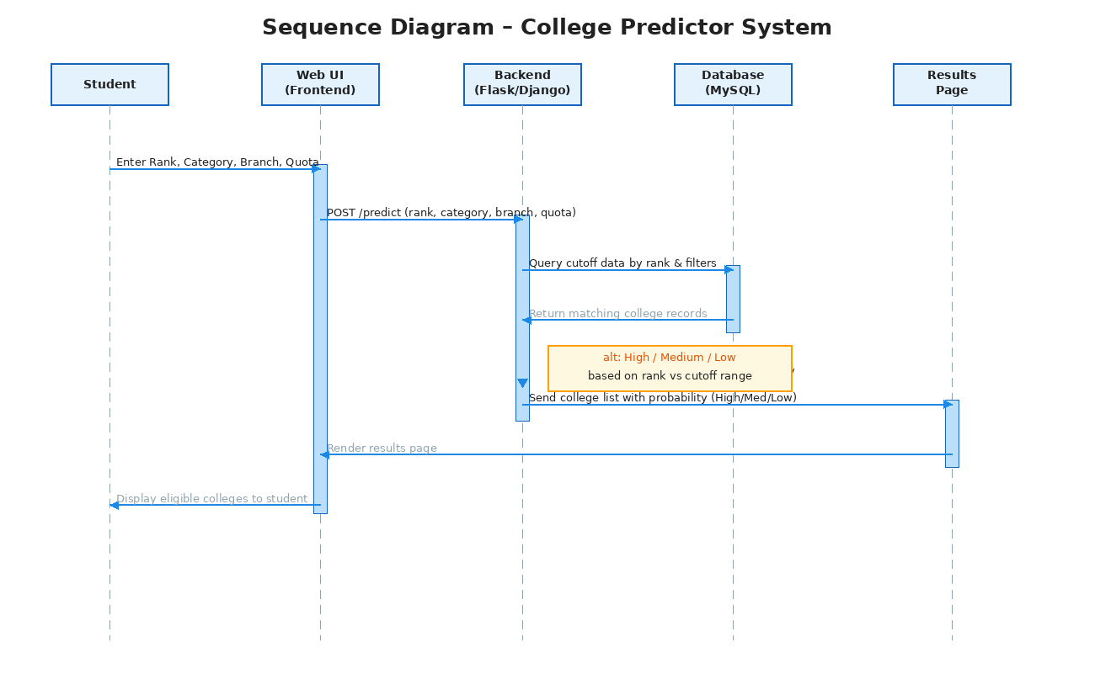
Sequence diagram
• The system architecture consists of a user interface, backend server, database, and recommendation logic.
• Users enter academic and preference details through the web interface.
• The backend processes the input data and compares it with historical cutoff information stored in the database.
• Eligible colleges along with admission probability, placement statistics, and reviews are displayed to the user.

Slide 13
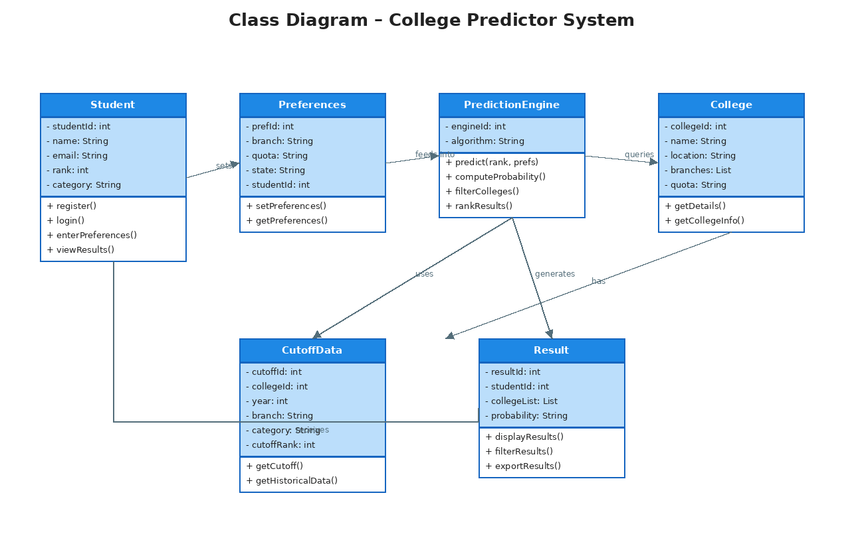
Class diagram
• The system architecture consists of a user interface, backend server, database, and recommendation logic.
• Users enter academic and preference details through the web interface.
• The backend processes the input data and compares it with historical cutoff information stored in the database.
• Eligible colleges along with admission probability, placement statistics, and reviews are displayed to the user.

Slide 14
References
• Official counselling and admission websites
• Previous year cutoff datasets
• Python and Flask documentation
• Database management system references
• Educational admission portals

Slide 15
Thank You

